Slide 1
Desired solution attributes/functionality:
Allow support users to fetch temporary credentials to customer database
Automatically revoke the credentials after a pre-defined interval, even in the case of a server restart, or other failure
Avoid running or managing infrastructure (servers)
Low cost of operations
Ensure an audit trail is available for security team to review usage
Secure and encrypt long-term database credentials – do not persist anywhere on disk or in code

Slide 2




PoC solution for automated self-service vending of temporary database credentials
Serverless solution using:
AWS Step Functions: visual workflow service to automate processes & orchestrate microservices
AWS Lambda: serverless platform for running event-driven code without infrastructure
Amazon ECS w/Fargate: scalable container orchestration without managing servers
AWS Secrets Manager: centrally-managed, secure, and serverless management of application secrets encrypted with AWS KMS
Lambda function code and website hosted in ECS written in C# targeting .NET 6 (Lambda functions) and .NET 8 (ASP.NET Core website)

Slide 3
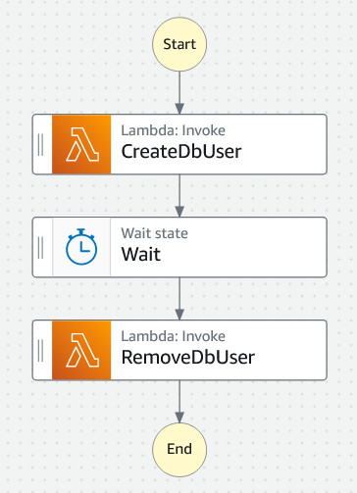








c
AWS Step Functions workflow
c
ECS
Service
ASP.NET Core web app
Create login + user
Support staff
Delete login + user
AWS Secrets Manager
VPC endpoint

